Slide 1
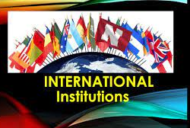
International Institutions & their Roles

Slide 2

Roles of International Institutions
Contribute largely nations of the world through:
political, economic & social development

Slide 3
Major International Institutions
The World Trade Organization (Multilateral Institution)
International Monetary Fund
World Bank
International Court
The United Nations (UN)
Caribbean Court of Justice

Slide 4

World Trade Organization – WTO
Est. January 1, 1995 - Marrakech Agreement
Objective
To supervise & liberalize international trade.
Agreement was signed by 123 countries on April 15, 1994.
WTO replaced the General Agreement on Tariffs and Trade (GATT) that was established in 1948.

Slide 5
Responsibilities of the WTO
Administering rules for trade among member countries
Principal international body for multilateral negotiations on the reduction of trade barriers and measures distorting competition
Platform for countries to raise their concerns regarding trade policies of their trading partners
Liberalization of world trade to contribute to economic growth and development
Promote of globalization

Slide 6

International Monetary Fund – IMF
International organization of 188 countries:
- fostering global monetary cooperation
- improve economies of member countries
- facilitate international trade
- promote high employment &
- sustainable economic growth & reduce poverty worldwide.
Members contribute funds to a pool through a quota system and countries with payment imbalances can borrow..
IMF’s objectives & functions are:
Providing short terms credit/financial resources to member countries for meeting temporary difficulties due to adverse balance of payments.
Reconciling conflicting claims of member countries
Providing a reservoir of currencies of member-countries
Promoting adjustment of exchange rates and exchange-rate stability
Advising members on economic, monetary and technical matters
Promotion of international economic cooperation, trade, & employment

Slide 7
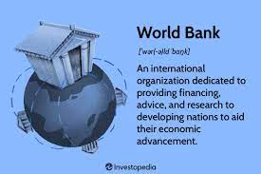
World Bank
An international financial institution of the United Nations, responsible for providing loans to developing countries.
The main objective is to reduce poverty worldwide

Slide 8

Functions
To provide long-run capital for economic reconstruction & development
To induce long-run capital investment
To provide a guarantee for loans granted to small and large units and other projects of members
To ensure the implementation of development projects to bring about a smooth transference from a war-time to peace economy.
To promote capital investment in member countries by the following ways:
To provide a guarantee on private loans or capital investment.
If private capital is not available even after providing guarantee, then loans will be provided for productive activities on considerate conditions.

Slide 9
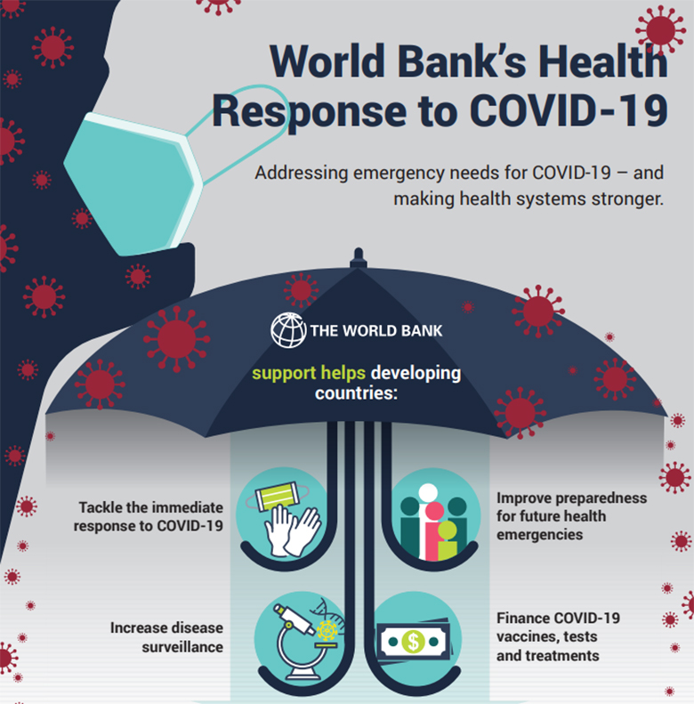
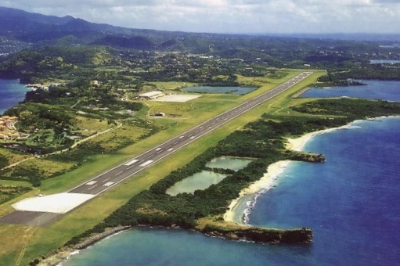
Grenada Projects
World Bank strengthens Grenada’s COVID-19 response with US$2.5 million
Newly approved World Bank financing to “enhance regional connectivity by improving the safety of air transport and the resilience of airport infrastructure to natural disasters.”

Slide 10
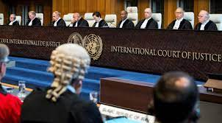
International Court of Justice - ICJ
Primary judicial branch of the UN – located
in the Netherlands.
Functions of the ICJ:
“The primary role of the ICJ is to settle legal disputes submitted to it by Members in accordance with international law, and to give advisory opinions on legal questions referred to it.
Court is composed of 15 judges, who are elected for terms of office of nine years by the UN General Assembly & Security Council.
Its official languages are English and French.”

Slide 11
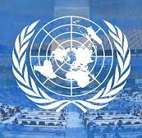
United Nations – UN
UN - inter-governmental organization established October 24, 1945;
Aim to promote international co-operation.
Membership of 193 countries with headquarters located in Manhattan, New York City, U.S.A.
The organization is financed by assessed and voluntary contributions from its member states.

Slide 12
Functions of the UN
Maintenance of international peace and security
Promotion human rights
Fostering global social and economic development
Protection of the environment
Provision of humanitarian aid in cases of famine, natural disaster, and armed conflict
There are also many subsidiary bodies, including committees, commissions, boards, councils, panels, and working groups some of which this list includes.

Slide 13
United Nations Charter 6 Principal bodies of the Organisation
The General Assembly
The United Nations Security Council
The Economic and Social Council
The Trusteeship Council (this Council suspended its operations in 1994)
The International Court of Justice
The Secretariat

Slide 14
UN Agencies
FAO Food and Agriculture Organization
AEA International Atomic Energy Agency
ICAO International Civil Aviation Organization
IFAD International Fund for Agricultural Development
ILO International Labour Organization
IFAD International Fund for Agricultural Development
IMO International Maritime Organization
IMF International Monetary Fund
ITU International Telecommunication Union
UNESCO United Nations Educational, Scientific and Cultural Organization
UPU Universal Postal Union
WK World Bank
WIPO World Intellectual Property Organization
WMO World Meteorological Organization
WTO World Tourism Organization
UNODC United Nations Office on Drugs and Crime
WHO World Health Organization

